Slide 1
Unit 9
What does he look like?
Section A 2a-2d
七年级(下)

Slide 2
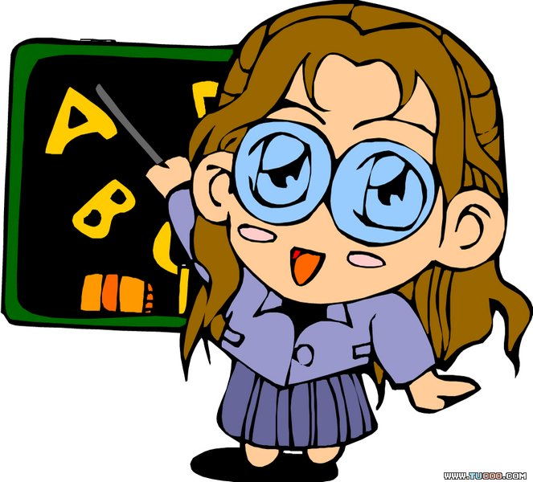
Objectives
To learn to use the alternative questions to ask people’s looks
To learn to describe people’s looks
To learn to use the following expressions:

Slide 3
Expressions:
be of medium height/build
go to the movie a little
see you later in the end
first of all
Sentence patterns:
What does he/she look like?
He’s tall. /She has long straight hair.
He’s thin/heavy.
She has curly hair.
Is he tall or short?

Slide 4

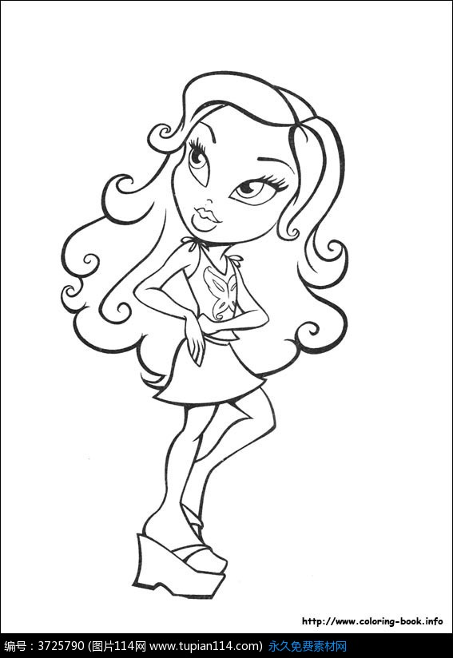
What does she look like?
She’s thin. She has curly hair.

Slide 5
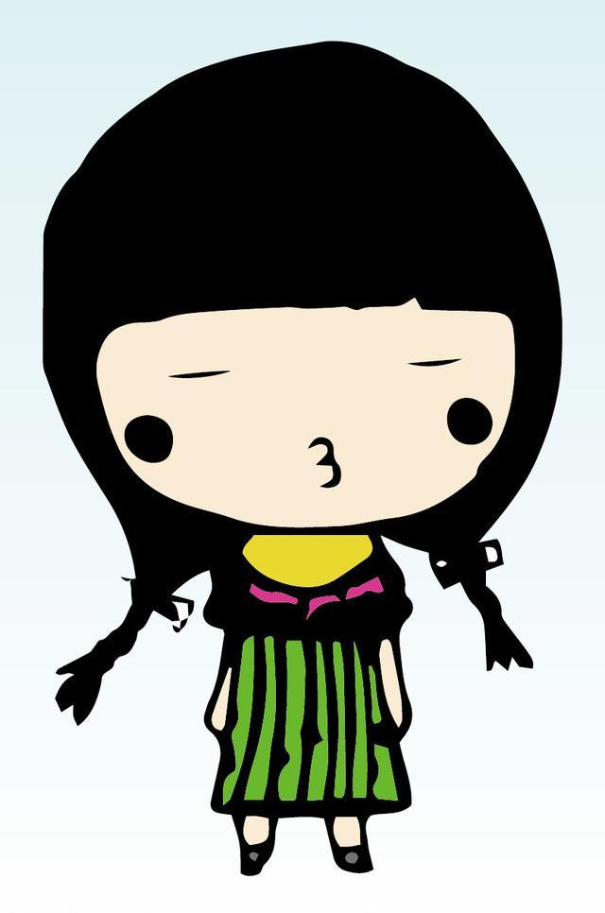
What does she look like?
She’s short. She has long
straight hair.

Slide 6
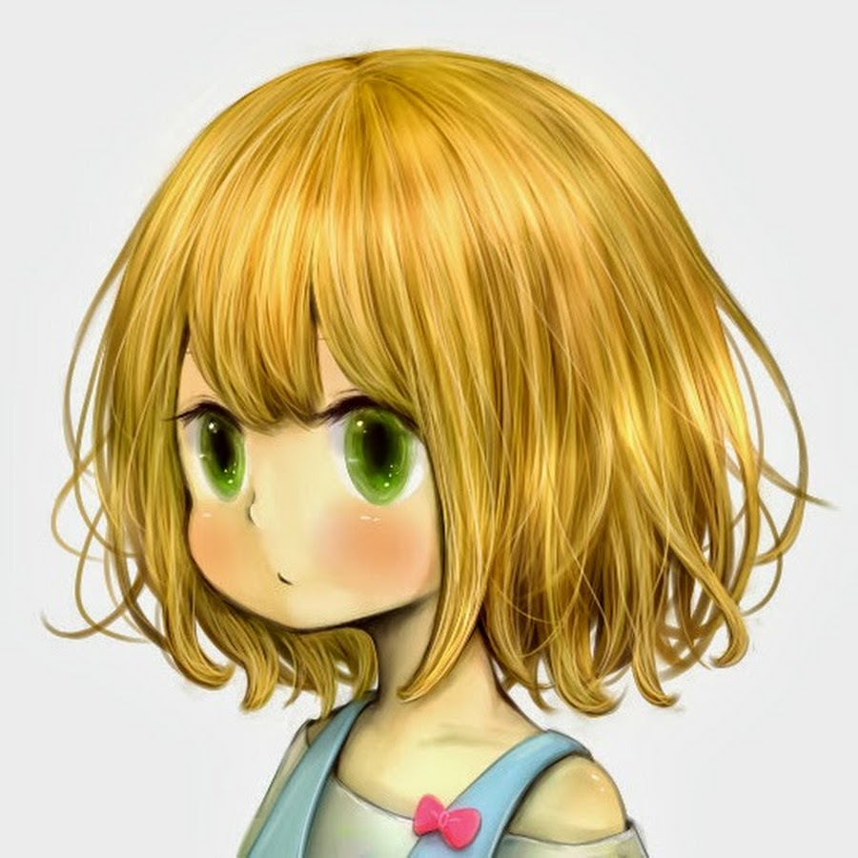
What does she look like?
She’s of medium height. She has short curly hair.

Slide 7
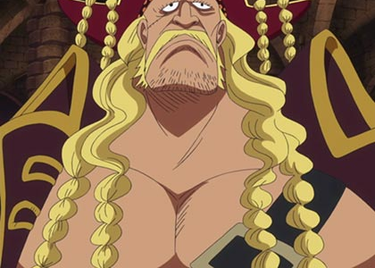
What does he look like?
He’s tall and heavy. He has long curly hair.

Slide 8
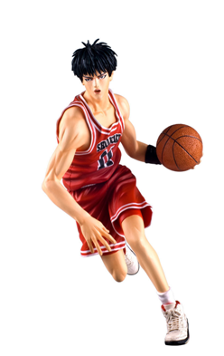
What does he look like?
He’s thin. He has short
straight hair.

Slide 9
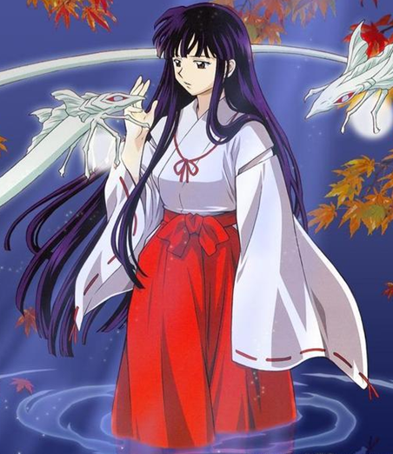
What does she look like?
She’s of medium height.
She has long hair.

Slide 10


2a. Listen and answer the questions.
1. Is David tall or short?
2. Does Sally have long or short hair?
3. Is Peter short or tall?
He is tall.
She has long hair.
He is short.

Slide 11
2b. Listen again. Fill in the chart.
 | David | Sally | Peter
is | heavy,
has
of medium
height, thin
tall
short
long straight
hair
curly hair
short hair

Slide 12
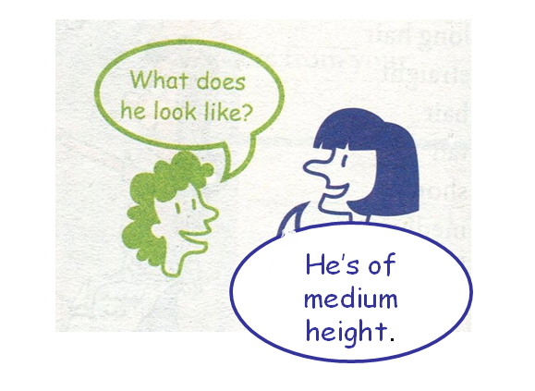
2c. Student A looks at the chart in 2b.
Student B asks Student A questions
about one of the people and then draws
a picture of the person.

Slide 13
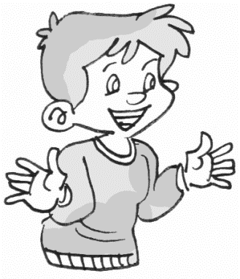
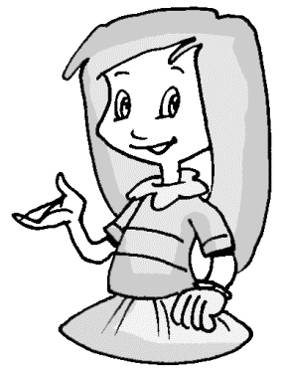
She’s thin and of medium height.
Is Sally thin or heavy?
Does she has long hair?
Yes. She has long straight hair.

Slide 14
He’s short and of medium build.
Is Peter tall or short?
Does he has long hair?
No, he doesn’t. He has short hair.

Slide 15

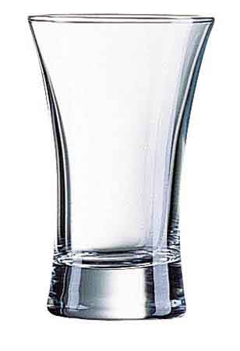
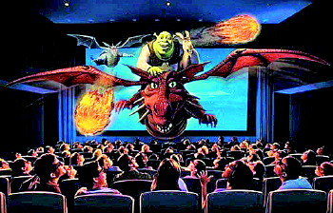
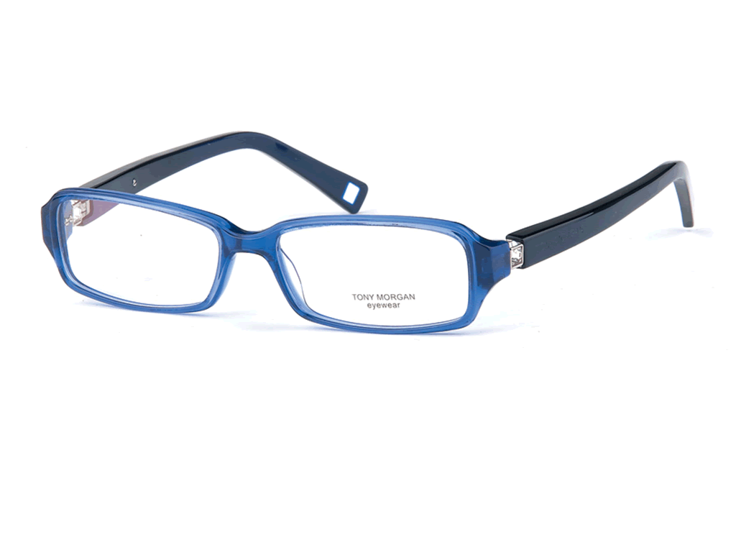
glass
glasses
cinema

Slide 16

2d. Role-play the conversation.
Mike: Hi, Tony. Are you going
to the movie tonight?
Tony: Yes. We’re meeting at
seven, right?
Mike: Yeah, but I may be a
little late. My friend
David is going, too. Just
meet him in front of the
cinema first.

Slide 17
Tony: Oh, but I don’t know him. What
does he look like?
Mike: Well, he has brown hair and wears
glasses.
Tony: OK. Is he tall or short?
Mike: He isn’t tall or short. He’s of medium height.
Tony: OK, sure. See you later then.

Slide 18
Reading
Read the conversation and answer
the questions.
Where are Mike and Tony going tonight?
_________________________
2. Where are they going to meet?
________________________________
________________________________
They’re going to the movie.
They’re going to meet in front of the cinema.

Slide 19
3. Who will Tony meet first at the cinema?
______________
4. What does David look like?
______________________________
______________________________
David.
He is of medium height, and has brown hair and wears glasses.

Slide 20
Language points
1. curly 作形容词，意为“卷曲的；卷毛的”。其反义词为straight，意为“直的”。例如：
Does she have curly hair or straight hair?
她的头发是卷发还是直发？

Slide 21
【回顾】straight 作副词，意为“直地； 笔直地”，例如：
Go straight along and then turn left.
2. height 作名词意为“高度”，例如：
What’s the height of the tree?

Slide 22
【拓展】high adj. 意为“高的”，通常用来修饰高大的建筑物。例如：
Mr. Smith works in that high building.
3. thin adj. 意为“瘦的”，其反义
词可以是 heavy；也可以是 fat (有点褒义)。例如：

Slide 23
My cousin is a little thin.
Mike’s grandpa is very heavy.
4. a little 意为“有点儿”，用来修饰形容词。例如：
It’s a little cold tonight.

Slide 24
【拓展】a little 意为“一些；少许”后 跟不可数名词。例如：
There’s a little meat in the bowl.
碗里有点肉。
5. glass 作“玻璃”讲时，是不可数名词；作“玻璃杯”讲时为可数名词；而glasses则是“眼镜”之意。例如：

Slide 25
Glass is broken easily.
玻璃很易碎。
There’s no water in your glasses.
你的杯子里没有水了。
Does she wear glasses?
她戴眼镜吗？

Slide 26
I. 选择所给词的适当形式填空
tall, huge, curly, thin, popular
1. Look! Miss Liu has _____ hair.
2. He is 1 meter 80 centimeters _____.
3. The TV play gets a ______ success.
4. She is ________ at school.
5. You should eat more. You’re too______.
curly
tall
huge
popular
thin

Slide 27
II. 选择填空
Mr. Simon ______ of medium build,
and he has yellow hair.
A. is B. has C. looks like D. isn’t
2. Jim has _____ curly hair.
A. a B. an C. the D. /
3. --What do you look like? -- I’m _____.
A. smart B. kind C. outgoing D. tall
A
D
D

Slide 28
4. Our English teacher _____ tall and he _____
of medium height.
A. has, has B. has, is C. is, has D. is, is
5. --Is he heavy?
--No, he is a little bit ________.
A. tall B. thin C. short D. quiet
6. --Is your friend quiet?
--No, he never stops ________.
A. talk B. talking C. to talk D. laughing
D
B
B

Slide 29
III. 翻译句子
1. 他长得什么样？
_______ _______ he _______ _______?
2. 她是一个满头卷发的可爱的女孩。
She is a _______ girl _______ _______
_______.
3. 我中等个。
I ____ ____ _________ _________.
What does
look like
lovely
with curly
hair
am of medium height

Slide 30
4. 他又高又瘦。
He is _______ and _______.
5. 那个棕色头发的高个子男孩子喜欢讲
笑话。
The tall boy _____ _______ ______ loves
to ______ ________.
tall
thin
with brown hair
tell jokes

Slide 31
Homework
1. Describe your parents and then
draw a picture of them.
2. Find a photo of your favorite star
on the internet and write a description.

Slide 32
Thank You!

